Slide 1


Header
Microsoft Virtual Academy
Mastering Xamarin Forms Development, Part 1
Pages, Layout, and Navigation
Scott J. Peterson
Produced by

Slide 2




Xamarin Forms Layout and navigation
App structure, page layout, and navigation are the foundation of an app's user experience. Xamarin Forms includes advanced gesture and navigation support, layouts, buttons, labels, lists, and other common controls, easily connected via shared backend code, to create fully native iOS, Android, and Windows app experiences.

Slide 3
Agenda In this session
Code sharing concepts
Basic UI concepts
Page concepts
Layout concepts
Layout controls
Demo: Using pages and layouts
Advanced layouts
Demo: Advanced layouts
Navigation basics
Demo: Basic app navigation
Next steps

Slide 4
Code Sharing Concepts Six and one-half dozen
The goal of a code-sharing strategy is to support an architecture where a single codebase can be utilized by multiple platforms. There are two methods for sharing code in Xamarin Forms:
Portable Class Library
Shared Project
App
Files referenced by the app
App
Files compiled in the app

Slide 5
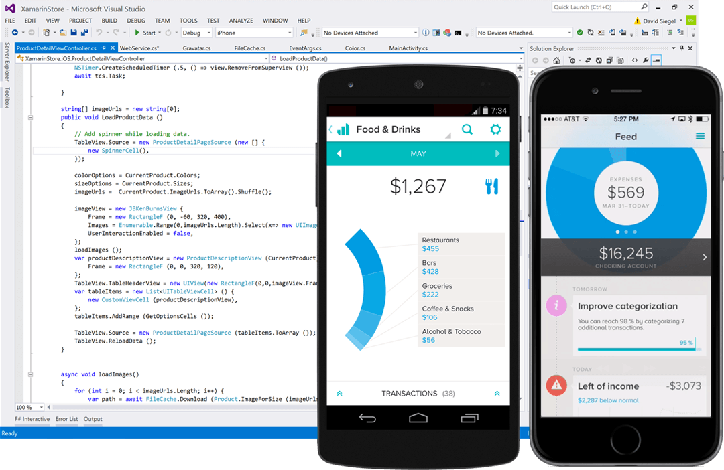



Basic UI Concepts Cross platform magic
Xamarin Forms apps are not just interpreted code, but instead use native APIs, user interface controls, and native compliers, including platform-specific hardware acceleration.

Slide 6
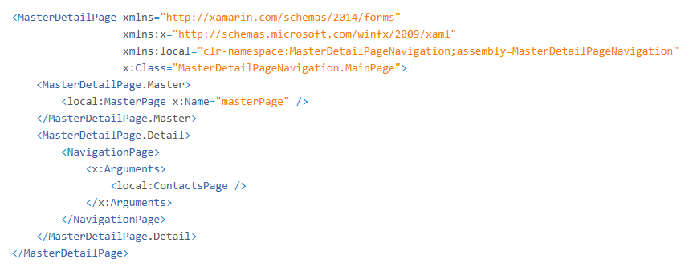

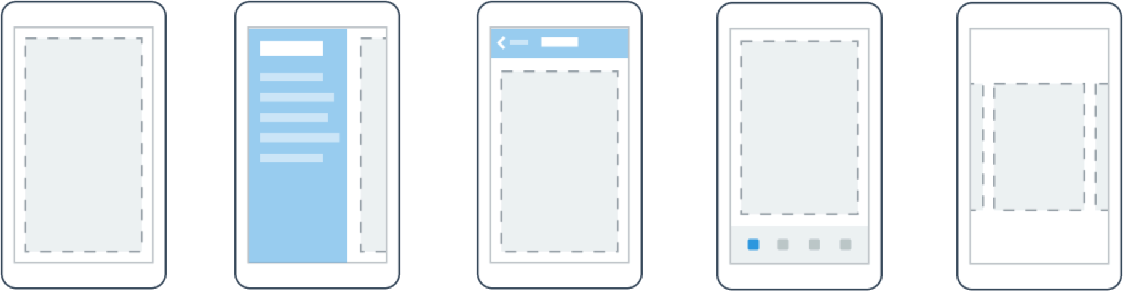
Page Concepts Can you be more specific?
In Xamarin Forms, a Page is a visual element that occupies most or all of the screen and contains a single child. A Page represents a View Controller in iOS, a Page in Windows, and acts a lot like an Activity on Android, but is not actually an Activity.

Slide 7
Page Concepts What’s available
Content Page
Navigation Page
Master/Detail Page
Tabbed Page
Carousel Page
Map Page
List View Page

Slide 8
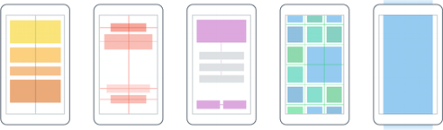
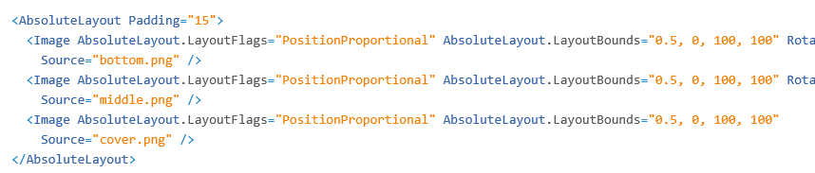
Layout Concepts Get into position
In Xamarin Forms, a Layout is a specialized subtype of a View, and ultimately acts as a container for other Layouts or Views. A Layout typically contains logic (either in XAML or code-behind) to set the position and size of child controls and elements in applications.

Slide 9
Layout Controls Fluid layout
The key to a responsive or “fluid” layout is the appropriate use of layout properties and panels to automatically and intelligently reposition, resize, and “reflow” content. With Xamarin Forms you can set a fixed size on an element, or use automatic sizing to allow a parent layout panel handle sizing and flow.
Margin
Padding
Content

Slide 10
Layout Controls Mix and match
Stack Layout
Absolute Layout
Grid (Layout)
Relative Layout
Scroll View
Custom Layouts

Slide 11
Demo
Using Pages and Layouts

Slide 12
Advanced Layouts Keep it simple
In most apps layout scenarios, more than one layout choice can be used to create your intended design. It’s common to have a number of reasonable layout choices, so consider which approach will be the easiest for your situation, and “nest” layouts as needed to create more complex designs.
Grid
StackLayout
StackLayout
Content
Content
Content
StackLayout
Content

Slide 13
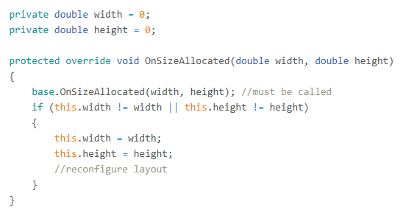
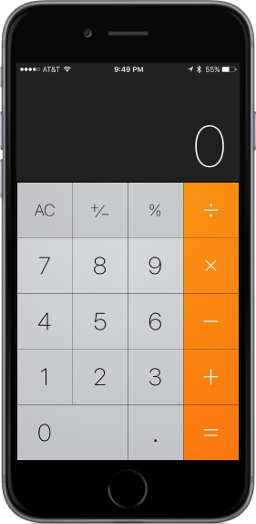
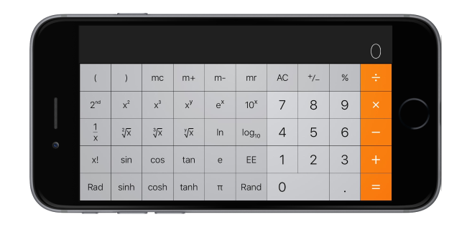
Advanced Layouts Respond gracefully
Although Xamarin Forms does not offer any native events for notifying your app of orientation changes in shared code, it’s simple to design interfaces using the built-in layouts so that they transition gracefully when the device is rotated using a combination of the right layout with a little code.

Slide 14
Demo
Advanced Layouts

Slide 15
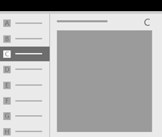
Navigation Basics Getting around
Navigation in Xamarin Forms apps is based on a flexible model of navigation structures, navigation elements, and system-level features. Together, they enable a variety of intuitive user experiences for moving between apps, pages, and content.

Slide 16
Navigation Basics The right combination
In a hierarchy
As peers
Between a parent page and its child pages
Between pages in the same level of the same subtree.

Slide 17
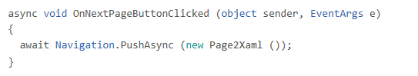
Navigation Targets Push and pop
Navigating content typically occurs against a Navigation, object. By default the app has a “root” page created when the app is initialized (launched) to serve as the “grandparent” for initial navigation, which can be created as a “navigation” page as needed.
Button
Page

Slide 18
Demo
Basic App Navigation

Slide 19
Next Steps
Review device layouts
Select and evaluate layout and navigation changes across a larger number of devices, especially phones vs. tablets and desktops.
Check for accessibility
Change accessibility settings like font size and magnification to review page and layout rendering on various platforms.
Migrate to using commands
Move click event based navigation to a command navigation model where events can easily be centralized and reused.

Slide 20
Mastering Xamarin Forms Development Pages, Layouts, and Navigation
Scott J. Peterson, MCSD, MCPSB, MCT
Chief Solution Architect
scott@liquiddaffodil.com

